Slide 1

Sprocket Central Pty Ltd
Data analytics approach
Data Insights - Kathleen, Satyam

Slide 2
Agenda
Introduction
Data Exploration
Model Development
Interpretation

Slide 3
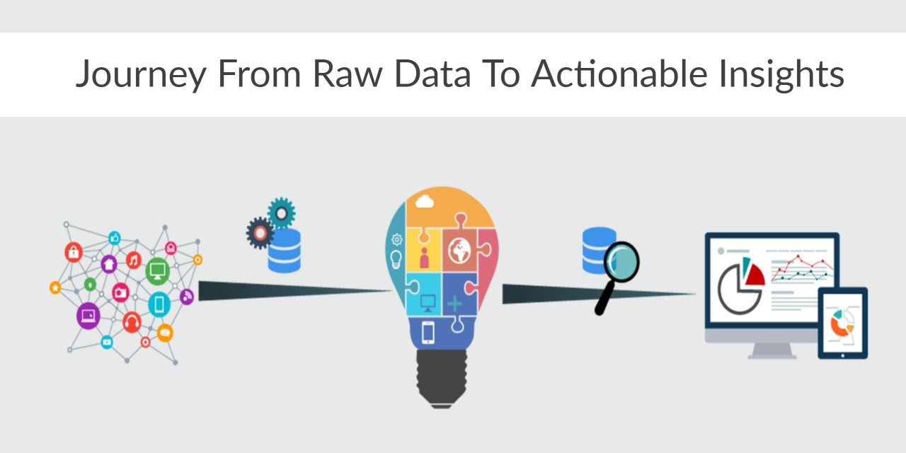
Introduction
How To Analyze The New 1000 Customer’s List?
For Retrieving Useful Customer Insights, Following are the categories on the basis of which the list should be analyzed :
Age based Sale Distribution
Industry based Sale Distribution
Sale in Past 3 years
Gender based Sale Distribution
Wealth Segment based Sale Distribution
Place any supporting images, graphs, data or extra text here.

Slide 4
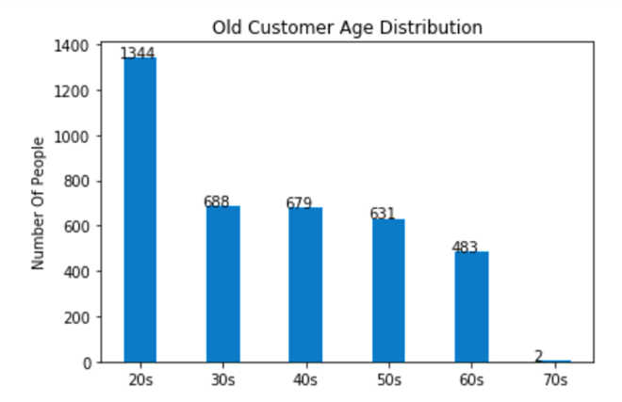
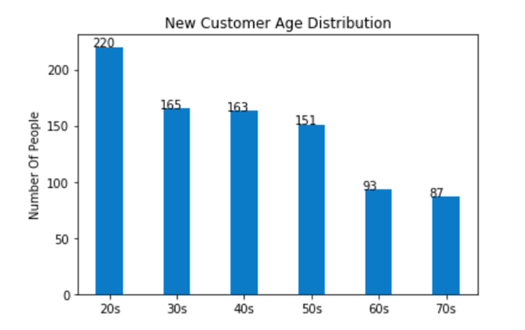
Data Exploration
Age Distribution Of Customers
Place any supporting images, graphs, data or extra text here.

Slide 5
Interpretation
Interpretation From Age Distribution Of Customers
Following are the inferences from previous slide :
Most of the customers belong to age-group of 20-40 years. Hence, This age group should be kept in focus in training dataset for the model.
Very less number of customers belong to age-group of 70-80 years. Hence, to optimize the training process, records belonging to this age-group can be ignored.

Slide 6
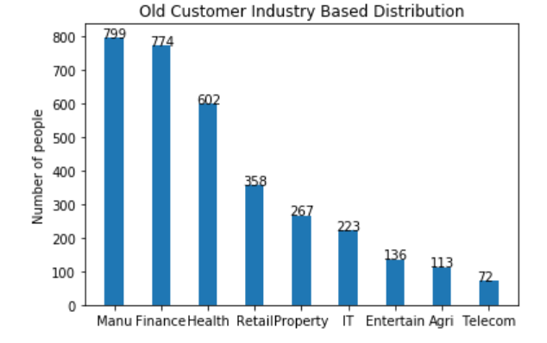
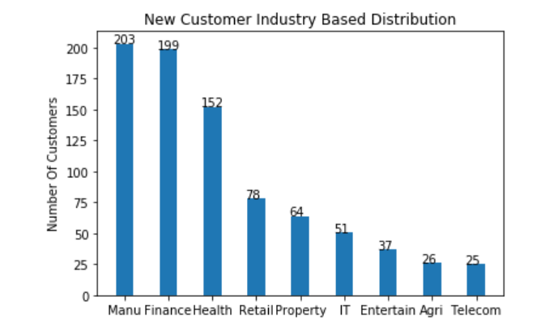
Data Exploration
Industry based Distribution of Customers
Place any supporting images, graphs, data or extra text here.

Slide 7
Interpretation
Interpretation From Industry based Distribution of Customers
Following are the inferences from the previous slide:
Most of the customers belong to Manufacturing, Finance & Health Industry. Hence, again they shall be kept in focus while assessing new datasets if provided.
Also, the same industries shall be kept in consideration while creating training datasets for the model.
Very less number of customers belong to Telecom industry, which decreases the probability of it as an output of our prediction model. Hence, it can be ignored to keep the optimization consistent.

Slide 8
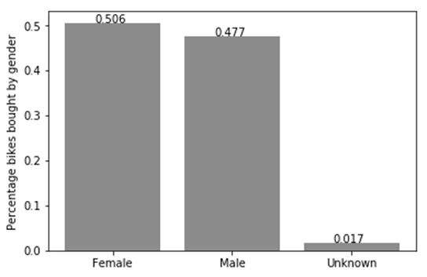
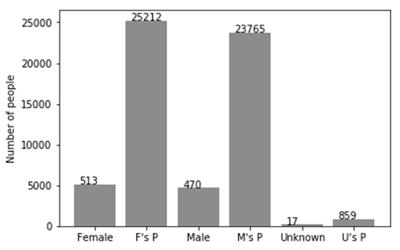
Data Exploration
Bike purchases last 3 years

Slide 9
Interpretation
Interpretation From Bike purchases last 3 years
Following are the inferences from the previous slide:
As we can see, our new customers mostly Female with 50.6% purchases with total of 25,212 bikes
Male contributed to 47.7% purchases with 23,765 bikes
So we should focus on advertises on Female customers than Male customers

Slide 10
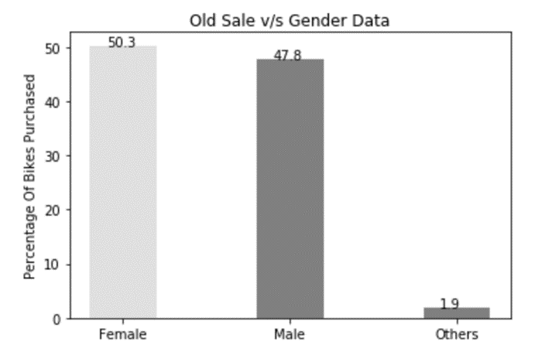
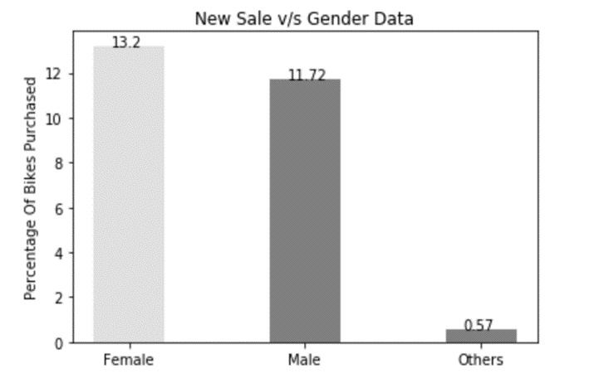
Data Exploration
Gender based Sale Distribution of Customers

Slide 11
Interpretation
Interpretation From Gender based Sale Distribution of Customers optimization
Following are the inferences from the previous slide:
50.3% of the total customers are females.
47.8% are males.
Since in both the old and new data, genders other than male and female consist of less than 2%, they can be ignored in further processes to optimize them.
In the training dataset, both male and female customers shall be taken into consideration.

Slide 12
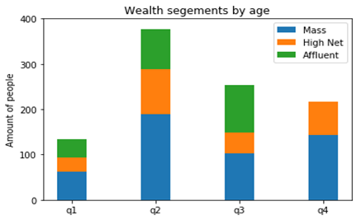
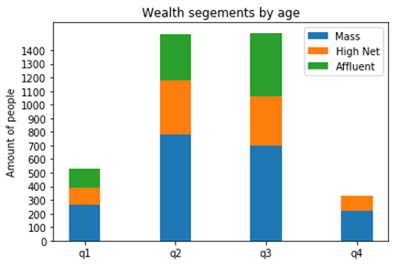
Data Exploration
Wealth segments based Sale Distribution of Customers

Slide 13
Interpretation
Interpretation From Wealth segments based Sale Distribution of Customers
Following are the inferences from the previous slide:
In all ages, the number of Mass Customers is the highest so we should focus on this social class.
After that, we should focus on High Net Customer.
Then Affluent Customers but mostly second and third quadrant

Slide 14
Thank You

